Slide 1
SC5010 PROJECT PRESENTATION
Group 4:
Huang Shi Yi (U2010610A)
Ho Jee Wen (U2011402E)
Sai Bulusu (U2123043F)
Loy Chai Ee (U2122250L)
Zhang Haozhe (U2221212E)

Slide 2
Overview
01
Motivation
02
Preprocessing
03
Exploratory Data Analysis
04
Machine Learning
05
Results & Analysis
06
Conclusion

Slide 3
MOTIVATION

Slide 4


Problem Description
Motivation
Problem Definition
Related Work
Predicting house prices in a city like Melbourne is important for a wide range of stakeholders.
Accurate house price predictions can inform decision-making and provide valuable insights into the dynamics of the housing market.
Identify the influence of different features on the price of houses in Melbourne using the Melbourne housing dataset
Develop a model that can accurately predict the price of a house based on its features
Requires careful data preparation, feature selection, and machine learning techniques
Nisaan Pow (2014)
housing price in Montreal
geographical location, residing area, no. of rooms, closest police station and hearthplace station, etc
Ravikumar (2017)
price prediction for the real estate markets and housing
random forest, gradient boosted trees, multi layer perceptron and ensemble learning models

Slide 5
PREPROCESSING

Slide 6
Data Cleaning
Outliers
Duplicates
For numeric attributes:
Landsize
BuildingArea
Distance
0 duplicate row found
Redundant Attributes
Missing Values
Address
Method
Postcode
Car (61) - remove
BuildingArea (6339) - replace
YearBuilt (5268) - replace
CouncilArea (1294) - replace

Slide 7



Handling Missing Values
BuildingArea (48%)
CouncilArea (10%)
YearBuilt (40%)
48% > 30%
Sparse column
→ Replace with KNN
Categorical
→ Replace with mode
40% > 30%
Sparse column
→ Replace with KNN

Slide 8

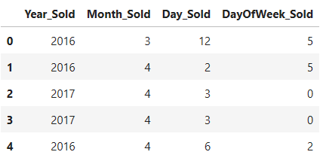
Data Transformation
YearBuilt
BuildingAge
Interval feature
Ratio feature
Date
Date sold
Numeric Data
Standardized Numeric data
Rooms, Distance, Bedroom2, Bathroom, Car, Landsize, BuildingArea, BuildingAge Lattitude, Longtitude, Propertycount
Not normalization as data contains many outliers

Slide 9
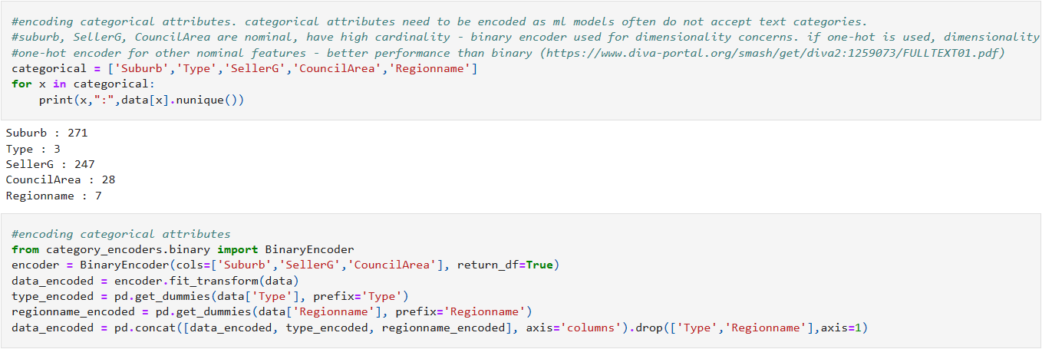
Encoding Categorical Attributes
Categorical attributes need to be encoded as ml models often do not accept text categories.
Suburb, SellerG, CouncilArea are nominal with high cardinality
binary encoder used for dimensionality concerns
if one-hot is used, dimensionality will be high, causing curse of dimensionality
One-hot encoder for other nominal features
better performance than binary

Slide 10
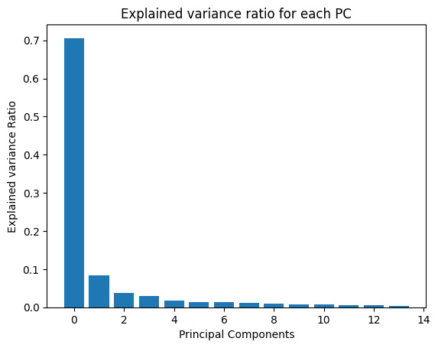
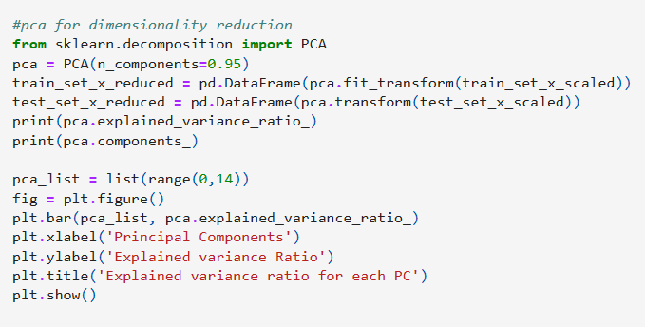
Principal Component Analysis
PCA for dimensionality reduction

Slide 11
EXPLORATORY
DATA ANALYSIS

Slide 12
Exploratory Data Analysis: Variables
Rooms: Number of rooms
Price: Price in dollars
Method: The method that the property is sold
Type: Housing type
SellerG: Real Estate Agent that sold the property
Date: Date sold
Distance: Distance from CBD
Regionname: General Region (West, North West, North, North east …etc)
Propertycount: Number of properties that exist in the suburb.
Bedroom2 : Scraped # of Bedrooms (from different source)
Bathroom: Number of Bathrooms
Car: Number of carspots
Landsize: Land Size
BuildingArea: Building Size
CouncilArea: Governing council for the area

Slide 13
Exploratory Data Analysis
After Data preprocessing, the data is then taken for exploratory analysis. We mainly want to see if there is any relationship between ‘Price’ and each individual predictor variable such as ‘BuildingAge’, ‘Distance’.
Response: “Price” Predictor: Rest of the columns in the dataset We split the predictors into 2 category:
Numeric: For Numeric variable such as "Landsize" and "BuildingArea". The relationship between price is plotted using scatterplot.
Categorical: For Categorical variable such as "Suburb" and "SellerG". The relationship between price is plotted using boxplot.

Slide 14
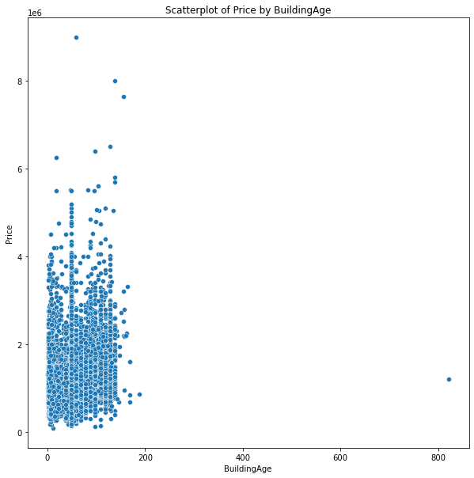
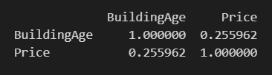
Numeric: BuildingAge against Price
From the scatterplot, it seems that there is general trend that the older the building the higher the price, however due to outliers the R coefficient is not very high. But we cannot see the relationship well with this scatterplot so we did a barplot.

Slide 15
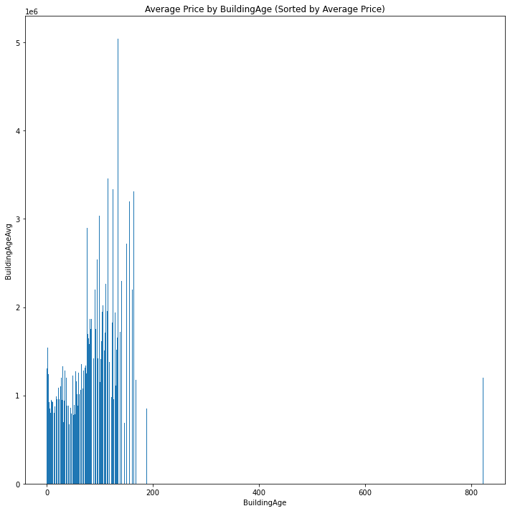
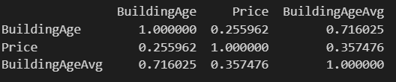
Numeric: BuildingAge against Price
This a barplot of the average price of each value of BuildingAge against price, you can see there is a general trend that price will increase as the building age increase, but up to a certain point. (Around 200 or more)

Slide 16
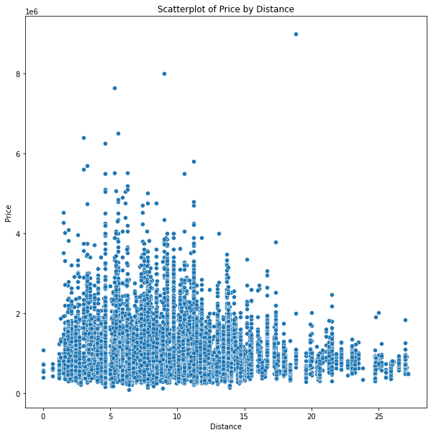

Numeric: Distance against Price
The scatterplot does not show any strong relationship between the Distance from Central Business District against Price. This is further supported by the low R coefficient

Slide 17
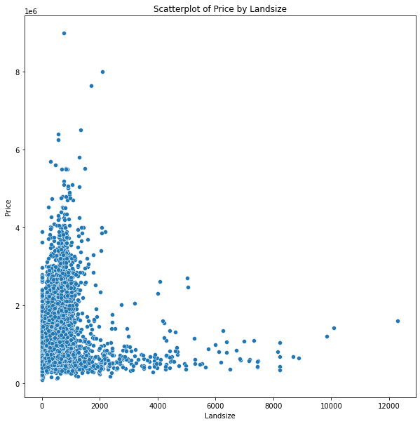

Numeric: Landsize against Price
The scatterplot shows a inverse relationship (1/x) as you can see the points are scattered such that it forms y = 1/x graph.

Slide 18
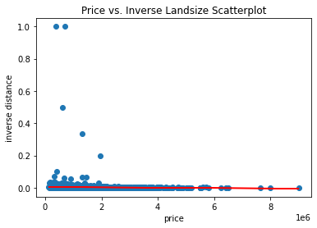
Numeric: Landsize against Price
From the previous graph we investigated that the point are scattered in a way it form y=1/x graph. Thus we inverse the value of Landsize and plot a scatterplot to see any linear relationship. However, linear relationship is not strong as seen from the graph

Slide 19
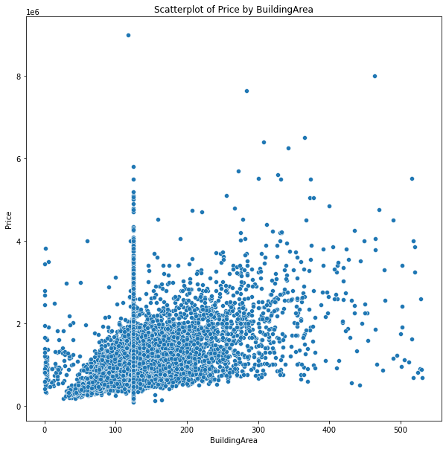

Numeric: BuildingArea against Price
The scatterplot does not show any strong relationship between the BuildingArea against Price. This is further supported by the high R coefficient. This is the highest R coefficient among the numeric variable, thus we should consider it for our model

Slide 20
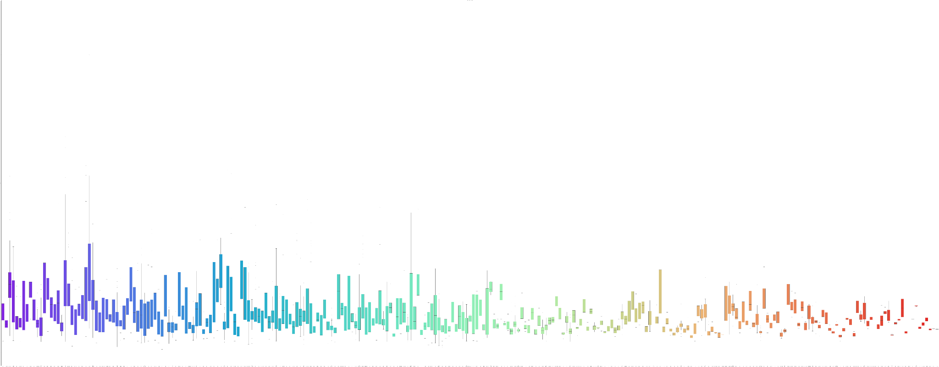
Categorical: Suburb vs Price
In suburb category there is way too many classes to determine any relationship using boxplot so we will be using target encoding for suburb to get a better visualisation of the relationship between Suburbs and price.

Slide 21
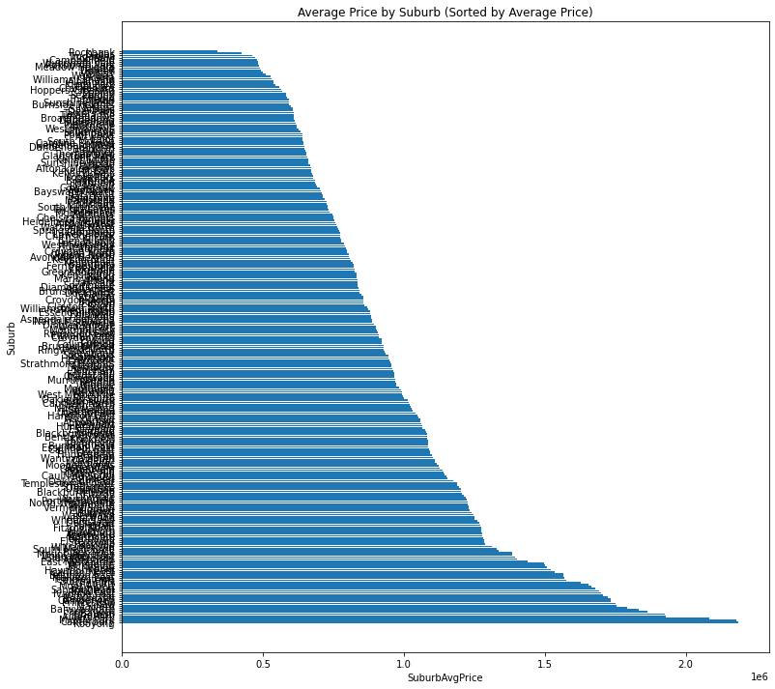
Categorical: Suburb vs Price
As Suburbs has too many classes, we decided to do target-encoding of the “suburb” variable. We take the average price of each class and plot a barplot to see if there is any difference. From the looks of it, Suburbs does affect the price but to a some extend as different suburbs has a medium range of price.

Slide 22
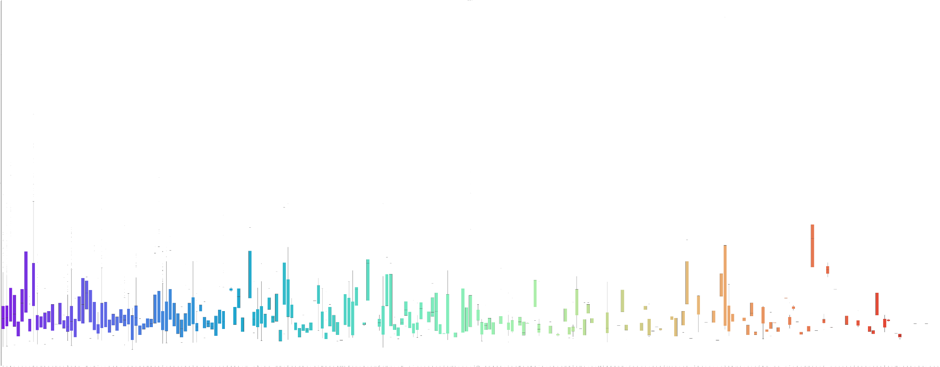
Categorical: SellerG vs Price
Similar to suburbs category there is way too many classes to determine any relationship of SellerG using boxplot so we will be using target encoding for suburb to get a better visualisation of the relationship between Suburbs and price.

Slide 23
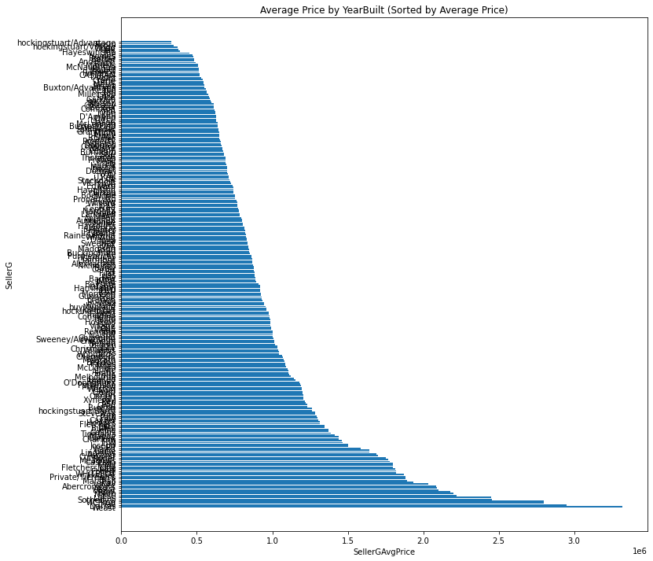
Categorical: SellerG vs Price
As Suburbs has too many classes, we decided to do target-encoding of the “SellerG” variable. We take the average price of each class and plot a barplot to see if there is any difference. From the looks of it, SellerG has a relationship with price as different suburbs has a wide range of price.

Slide 24
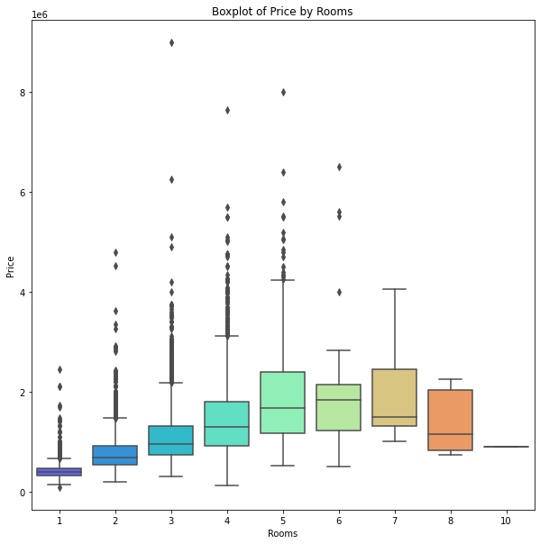
Categorical: Rooms vs Price
For Rooms, the boxplot shows that there is slight relationship between the number of rooms and price. This is seen from the increase of median price of each class as the number of rooms increase. However, this general rule do not apply 6 rooms or more.

Slide 25
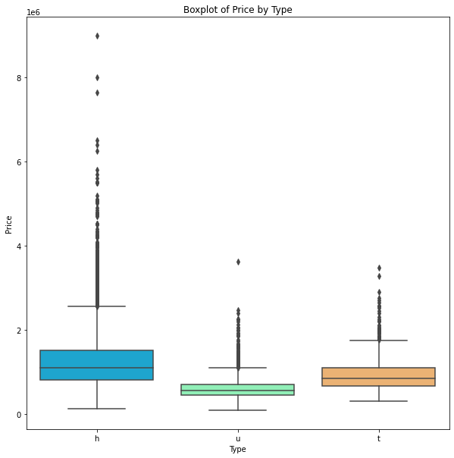
Categorical: Type vs Price
For Type, there is no relationship between price as there is no significant difference in terms of their price and type

Slide 26
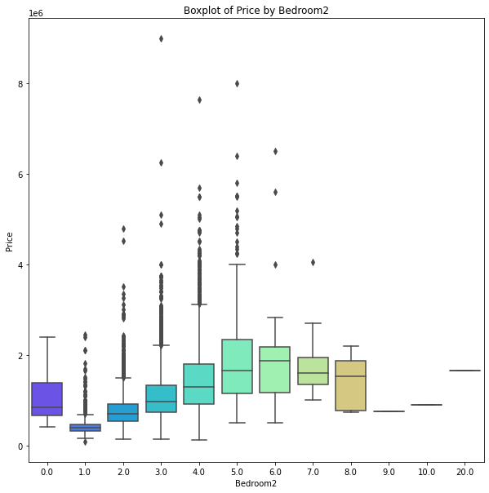
Categorical: Bedroom vs Price
For Bedrooms, the boxplot show that there is slight relationship between the number of bedrooms and price as the median price of each class is increasing as the number of rooms increase. However, there are two exception, houses that have 0 bedrooms, and houses that have more than 7 bedroom

Slide 27
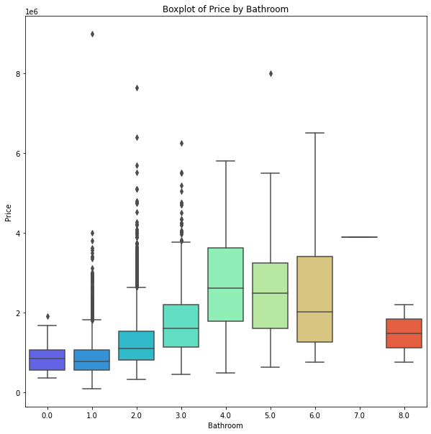
Categorical: Bathroom vs Price
Similar to Bedrooms, the boxplot show that there is slight relationship between the number of bathrooms and price as the median price of each class is increasing as the number of rooms increase. However, there are two exception, houses that have more than 6 bedroom

Slide 28
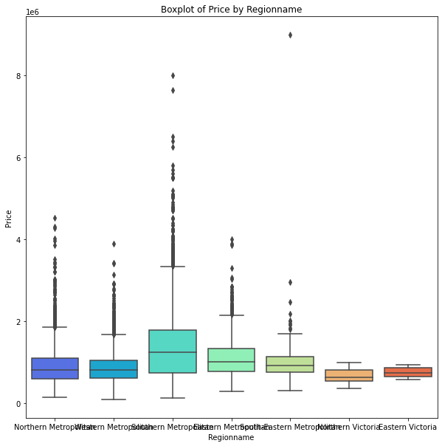
Categorical: RegionName vs Price
From the boxplot, there is not much significant difference in terms of price and regionname as the box plot shows that the median of price is quite close to each region name which is not showing any differences at all

Slide 29
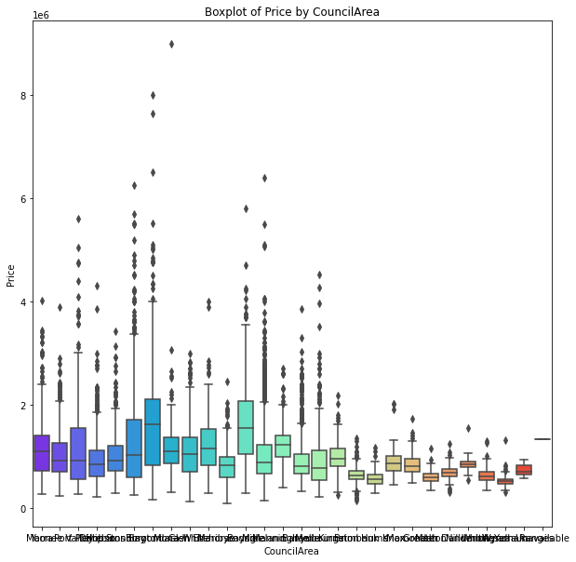
Categorical: CouncilArea vs Price
Similar to suburbs category there is way too many classes to visualise any relationship of CouncilArea using boxplot so we will be using target encoding to get a better visualisation of the relationship between Suburbs and price.

Slide 30
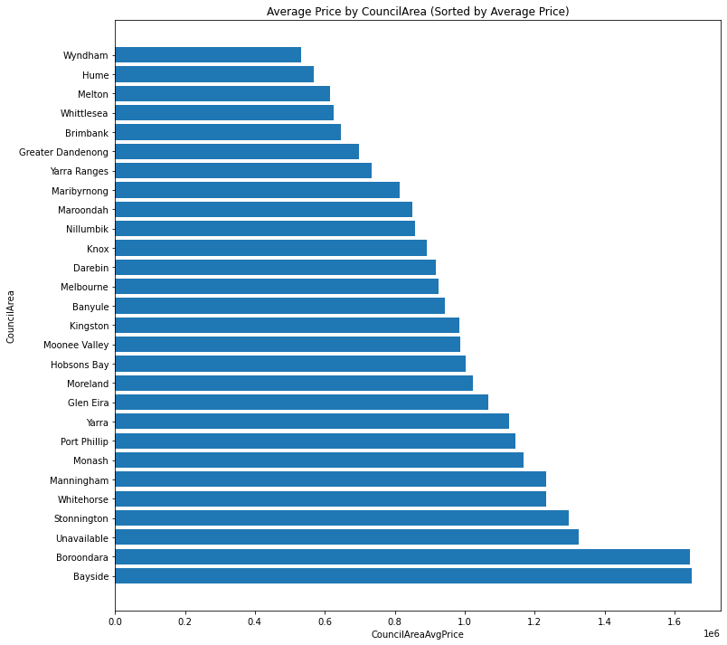
Categorical: CouncilArea vs Price
From the barplot, the range of the average price of CouncilArea is small (0.0 to 1.6), thus we can conclude that CouncilArea affect the price to a small extend and may not need to be considered for our model.

Slide 31
Exploratory Data Analysis
The predictors we will be considering in the model are:
Suburb
Number of rooms
SellerG
CouncilArea
BuildingAge
BuildingArea
As these predictors have a decent relationship with the price.
Notes:
After doing Exploratory data analysis, we find that Suburb, number of rooms, SellerG, CouncilArea, BuildingAge and BuildingArea have a decent relationship to price.

Slide 32
MACHINE LEARNING

Slide 33
Machine Learning Process
Model Selection
Hyperparameter Tuning
Linear regression with ridge regularization
Polynomial regression with ridge regularization
XGBoost
Random Forest
Model Training
10-fold cross validation
‘RandomSearchCV’ function
Performance Evaluation
MAE
MSE
Finding Most Important Features

Slide 34
Linear Regression with Ridge Regularization
Makes predictions by computing the weighted sum of input features plus an intercept
Ridge regularization: Minimize overfitting and poorer performance on test data
Ridge over Lasso: Lasso tends to reduce less important features’ weights down to 0
As trivial features are likely to be removed during preprocessing already, we believe this reduction will not be needed

Slide 35
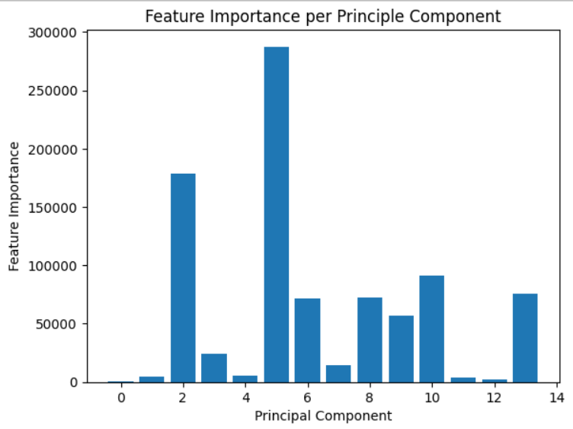
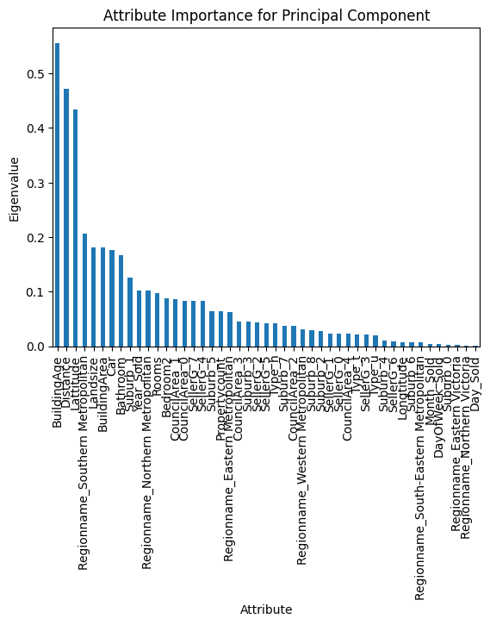
Linear Regression with Ridge Regularization:
Finding the Most Important Features
The most important principal component is found from the weights obtained from the model
Obtain the eigenvalues of all features forming the principal component

Slide 36
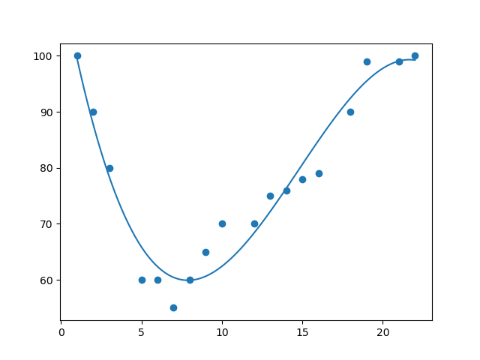
Polynomial Regression with Ridge Regularization
Data may be more complex than a straight line and may have polynomial relationships
Polynomials of each feature and combinations of features, up to a given degree, are added

Slide 37
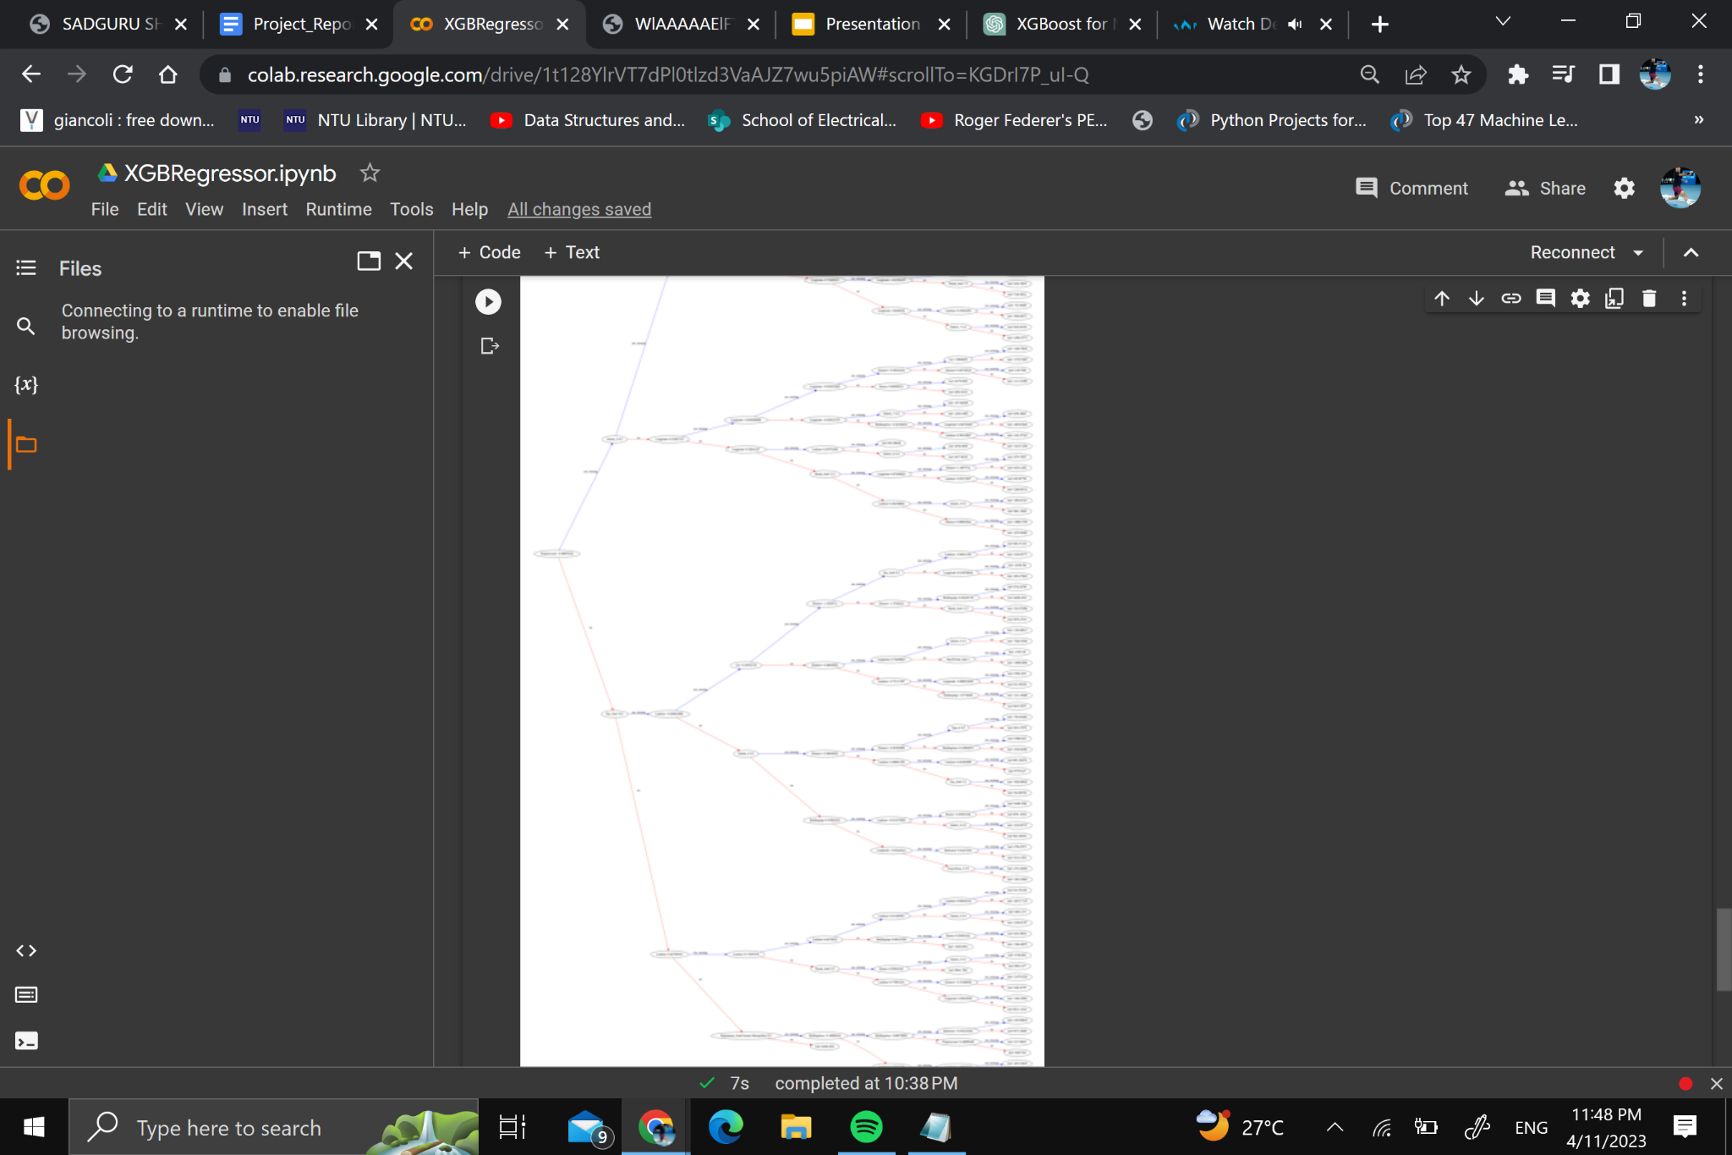
XGBoost Regressor
It is an ensemble method that builds a series of decision trees and continuously corrects errors from the previous tree.
It uses gradient boosting ( a method of fitting a model to the negative gradient to the loss function) to adjust the predictions of each new tree.
XGBoost provides regularization techniques to prevent overfitting, and makes predictions by combining the predictions of all the trees in the ensemble.

Slide 38
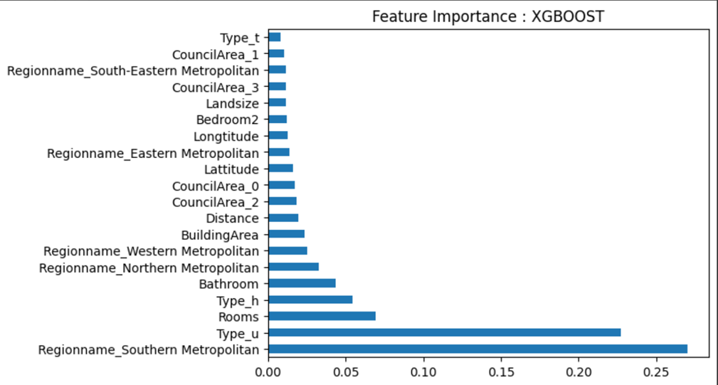
Feature Importance for XGBoost
XGBoost calculates feature importance by considering the number of times a feature is used to split a node and the improvement to the model's performance achieved by each split
This information is combined into a weighted score, which is then normalized to make it easier to interpret the results.

Slide 39
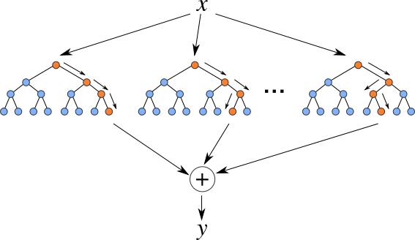
Random Forest Regressor
It is also an ensemble method that builds a series of decision trees by randomly selecting the features and training samples, and then aggregates their predictions.
It uses specific criterion such as Mean Squared Error (MSE) or Mean Absolute Error (MAE) for each tree and averages their predictions for the final prediction

Slide 40
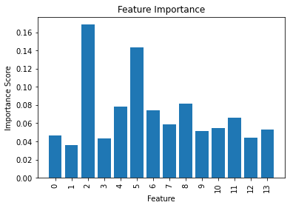
Feature Importance - Random Forest
Random Forest calculates feature importance by measuring how much each feature contributes to decreasing the impurity of the nodes.
Uses gini and entropy criteria.
Features that lead to greater impurity reduction have higher importance.

Slide 41
RESULTS & ANALYSIS

Slide 42
Hyperparameter Tuning using 10-fold Cross Validation
Linear Regression with Ridge Regularization
Hyperparameter | Description | Inputted/ Possible Range of Values | Result
Alpha | Constant that multiplies the L2 term, controlling regularization strength. | 0 to 10 | 9.64
Larger the Alpha → Higher is the smoothness constraint
Notes:
Alpha is the regularization strength, so a large alpha will produce a "smoother" regression at the expense of a worse fitting of the data
the hyperparameter tuning results for linear regression with ridge regularization is alpha = 9.64. A large alpha will produce a smoother regression

Slide 43
Hyperparameter Tuning using 10-fold Cross Validation
Polynomial Regression with Ridge Regularization
Hyperparameter | Description | Inputted/ Possible Range of Values | Result
Alpha | Constant that multiplies the L2 term, controlling regularization strength. | 0 to 10 | 6.46
Degree | maximal degree of the polynomial features | 1 to 5 | 2
Interaction_only | If ‘True’, only interaction features are produced. | True, False | False
Notes:
The results for polynomial regression with ridge regularization is alpha = 6.46, degree of polynomial features = 2, and interaction features only being produced is false

Slide 44
Hyperparameter Tuning using 10-fold Cross Validation
XGBoost
Hyperparameter | Description | Inputted/ Possible Range of Values | Result
subsample | the fraction of features used for training | 0.6-0.9 | 0.8
Gamma | minimum loss reduction required to make a further partition on a leaf node of the tree. | 0-3 | 0
No of estimators | Number of decision trees | 50-200 | 150
Max depth | the maximum depth of each decision tree in the ensemble. | 3-9 | 7
colsample_bytree | the fraction of features used for training each tree. | 3-9 | 0.7
Learning rate | the step size at which the boosting algorithm descends down the gradient. | 0.05-2.0 | 0.1
Applied the XGBoost regressor and fine-tuned its hyperparameters using RandomizedSearchCV
Notes:
we have applied the XGBoost regressor and fine-tuned its hyperparameters using RandomizedSearchCV
And the results are subsample = 0.8, gamma = 0, number of decision trees = 150, fraction of features used = 0.7, and learning rate = 0.1

Slide 45
Hyperparameter Tuning using 10-fold Cross Validation
Random Forest
Hyperparameter | Description | Inputted/ Possible Range of Values | Result
bootstrap | Bootstrapping is the sampling the data with replacement | True or False | False
n_estimators | specifies the number of decision trees in the random forest | 10 to 500 | 125
max_depth | maximum depth of each decision tree in the random forest | 1 to 50 | 6
max_features | maximum number of features that can be considered for splitting a node | 1 to the number of features, or auto | auto
min_samples_split | minimum number of samples required for splitting | 2 to 20 | 5
min_samples_leaf | minimum number of samples required to be at a leaf node | 1 to 10 | 2
Notes:
For the results on random forest model, the bootstrapping is false, the number of decision trees is 125, maximum depth is 6, maximum number of features is set at auto. Min number of samples for splitting is 5, and the min number of sample required to be at the lead node is 2.

Slide 46
Features Relative Influence
Model | Most Important Features
Linear Regression with Ridge Regularization | ‘BuildingAge’, ‘Distance’, ‘Latitude’
Polynomial Regression with Ridge Regularization | ‘Landsize’, ‘Distance’, ‘Latitude’
XGBoost | ‘Regionname_Southern’, ‘Distance’, ‘Rooms’
Random Forest | ‘BuildingAge’, ‘Distance’, ‘Latitude’
‘BuildingAge’, ‘Distance’, ‘Latitude’, ‘Landsize’, ‘Regionname_Southern‘, ‘Rooms’ are the most important features across all models.
Notes:
Based on the models we used, we can find out that building age, distance, latitude, landsize, Southern region name, and rooms are the features that have the highest relative influence.

Slide 47
Performance Evaluation
Model | Training Set MSE | Test Set MSE | Training Set MAE | Test Set MAE | Training Time
Linear | 1.74*10¹¹ | 1.72*10¹¹ | 2.81*10⁵ | 2.80*10⁵ | 0.29 seconds
Polynomial | 1.26*10¹¹ | 1.41*10¹¹ | 2.35*10⁵ | 2.41*10⁵ | 8.44 seconds
XGBoost | 1.66*10¹⁰ | 6.70*10¹⁰ | 8.9* 10⁴ | 1.55*10⁵ | 7.34 seconds
Random Forest | 2.48*10⁵ | 2.70*10⁵ | 1.87*10¹¹ | 1.91*10¹¹ | 24.7 seconds
In terms of MAE, XGBoost model have a better performance
In terms of MSE, Random Forest model have a better performance
The Random Forest model performed better in dealing with outliers compared to XGBoost because MSE tends to penalize outliers more than MAE. However, in general, XGBoost exhibited a more accurate response.
Notes:
Random Forest model performed the best with regards to MSE, while XGBoost performed the best with regards to MAE. As MSE tends to penalize outliers more than MAE, Random Forest model did better in terms of handling outliers, while XGBoost did better generally.

Slide 48
Pros & Cons
Pros
Met objectives of finding the influence of different features and predictions for prices. Find out that ‘BuildingAge’, ‘Distance’, ‘Latitude’, ‘Landsize’, ‘Regionname_Southern‘, ‘Rooms’ are the most important features across all models.
Cons
Dataset is outdated (compiled in 2018) Over time these relationships and patterns may change. It may not accurately represent the current situation, and thus the predictions made on the price may differ. Additionally, having more features available can provide a more comprehensive understanding of the problem. Which can lead to a stronger prediction results.
Notes:
Pros: Met objectives of finding the influence of different features and predictions for prices.
Cons: Dataset is outdated (compiled in 2018) so relationships may have changed. More features available could give stronger prediction results.

Slide 49
CONCLUSION

Slide 50
Conclusion
Identified influence of different features on price of houses in Melbourne
Improvements
More recent data points to derive up-to-date relationships
E.g. Economic indicators to give a better prediction
Melbourne Housing Dataset
XGBoost
Best Model for predicting price
Notes:
Using the Melbourne housing dataset, we have identified the influence of different features on the price of houses in Melbourne and found the model that can most accurately predict the price, XGBoost.
The ways that our model can improve is by having more recent data points that can help to derive up-to-date relationships between the features and housing prices. For example, Information on more factors, such as economic indicators, can be obtained to give a better prediction.

Slide 51

Thank You

